Slide 1
Important Note Regarding This Microsoft PowerPoint Presentation
* Do not include this slide in your presentation *
This slide deck has been intentionally provided with very limited graphics and formatting to simplify content integration into your own preferred PowerPoint themes and styles.

Slide 2
Security Development Lifecycle (SDL) Field Content
Code Analysis
(Level 200)

Slide 3
Agenda
Overview of the Microsoft SDL
Overview of code analysis
Microsoft code analysis tools:
FxCop
PREFast
Visual Studio Code Analysis feature
ASP Source Code Analyzer for SQL Injection
Microsoft SDL code analysis requirements

Slide 4

Microsoft Security Development Lifecycle (SDL)
Training
Requirem-ents
Design
Implemen-tation
Verification
Release
Response
Delivering secure software requires:
Executive commitment → SDL a mandatory policy at Microsoft since 2004
Education
Technology and Process
Accountability
Ongoing Process Improvements → 6 month cycle

Slide 5
Code Analysis Overview
Code Analysis Tools: Software tools that analyze application implementations for conformance to best practices
Two types:
Static source code analysis
Binary analysis
These tools are not “silver bullets” for identifying non-conformance to best practices
Can greatly reduce engineering costs

Slide 6


Static Analysis Versus Binary Analysis
COMPILER &
LINKER
Source Code
Binary File
void function(char * str)
{
char buffer[32];
strcpy(buffer,str);
}
void main(int argc, char ** argv)
{
function(argv[0]);
printf(argv[0]);
}
mov eax, DWORD PTR _str$[ebp]
push eax
lea ecx, DWORD PTR _buffer$[ebp]
push ecx
call _strcpy
add esp, 8
…
mov edx, DWORD PTR _argv$[ebp]
mov eax, DWORD PTR [edx]
push eax
call _printf

Slide 7
Static Source Code Analysis
Static Source Code Analysis Tools: Software tools that analyze the uncompiled source code implementations of applications for areas of improvement
Inputs: Human-readable source code, such as C (*.c), C++ (*.cpp, *.cc) or C# (*.cs) files
Some key advantages:
Easier to diagnose findings
More mature technology

Slide 8
Binary Code Analysis
Binary Code Analysis Tools: Software tools that analyze the compiled or binary version of source code implementations for areas of improvement
Inputs: Machine code or binary files, such as executable (*.exe) and library (*.dll) files
Key advantage:
Binary analysis tool have visibility into the compiled code itself

Slide 9
Code Analysis Pros and Cons
Pros
Helps scale the code review process
Helps enforce secure-coding policies
Cons
False positives
False negatives
Language-centric
Source-level issues only

Slide 10
Microsoft FxCop
FxCop: An application that analyzes managed code assemblies for conformance to the Microsoft .NET Framework Design Guidelines
http://msdn.microsoft.com/en-us/library/bb429476(VS.80).aspx
Binary code analyzer for .NET assemblies
Can be fully integrated into the software development lifecycle
In addition to security checks, FxCop analyzes assemblies for areas of improvement in design, localization, and performance

Slide 11
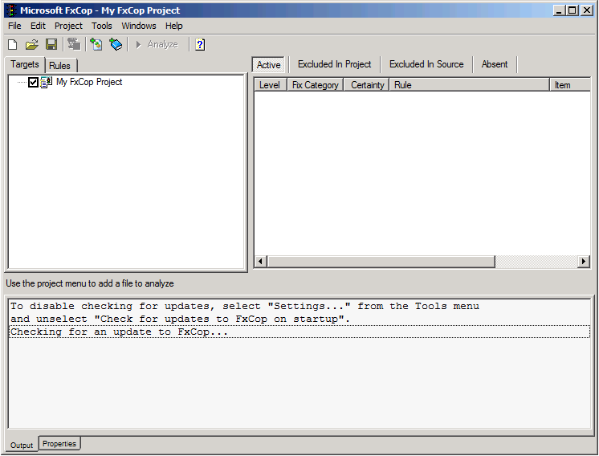
FxCop Demonstration

Slide 12
Microsoft PREFast
Microsoft PREFast: An application that identifies vulnerabilities in C/C++ source code
http://www.microsoft.com/whdc/DevTools/tools/PREfast.mspx
Static source code analyzer for C/C++ applications
Can be fully integrated into the software development lifecycle
Distributed with the Windows Driver Kit (WDK), but can be used to analyze non-driver code written in C/C++

Slide 13
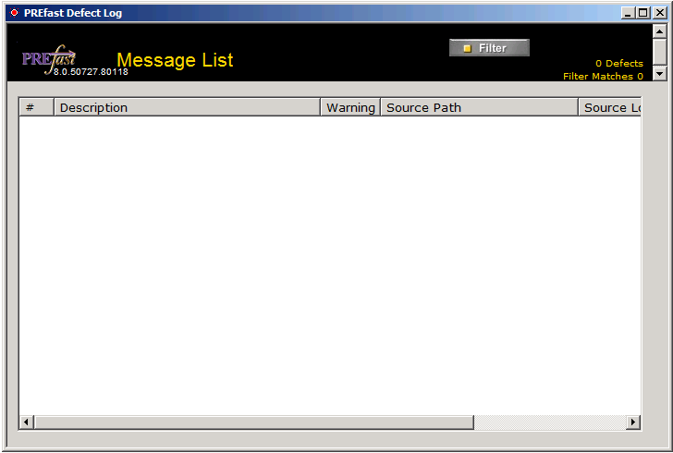
PREFast Demonstration

Slide 14
Visual Studio Code Analysis
Microsoft Visual Studio Team System and higher versions provide the capabilities of PREFast and FxCop integrated into the development environment
http://msdn.microsoft.com/en-us/library/ms182025(VS.80).aspx
Enabled via /analyze command-line switch or through Visual Studio project properties settings

Slide 15
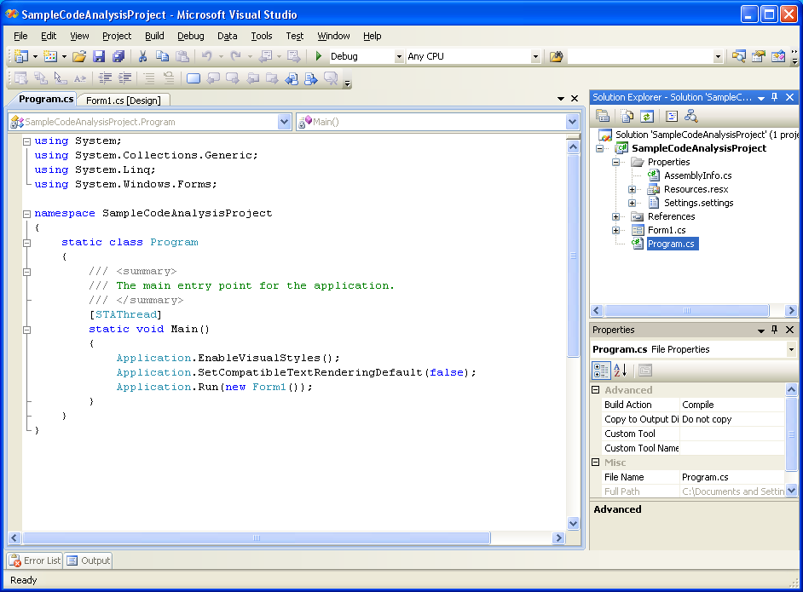
Visual Studio Code Analysis Demonstration

Slide 16
ASP Source Code Analyzer for SQL Injection
Microsoft Source Code Analyzer for SQL Injection tool helps developers and testers find certain SQL injection vulnerabilities in ASP code
http://support.microsoft.com/kb/954476
Command-line static source code analysis tool
Limited to analyzing ASP pages that are written in VBScript

Slide 17
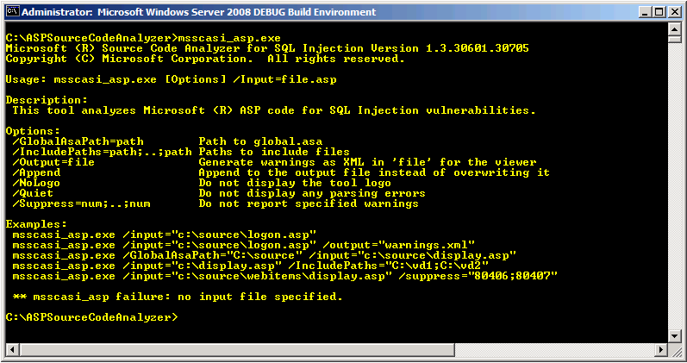
ASP Source Code Analyzer for SQL Injection Demonstration

Slide 18
Microsoft SDL Code Analysis Requirements
Organizations that use source code analysis tools or are considering using them should develop code analysis tool policies
The Microsoft SDL provides specific requirements for using PREFast, FxCop and Visual Studio
Example: Developers must fix Visual Studio /analyze warnings 4532, 6029, 6053, 6057, 6059, 6063, and much more
For more information, refer to the Microsoft SDL whitepaper (Appendix E) at http://www.microsoft.com/sdl or the Microsoft SDL book (Chapter 21) at http://www.microsoft.com/mspress/books/8753.aspx

Slide 19
Conclusion
Overview of Microsoft SDL
Overview of code analysis
Microsoft code analysis tools
Microsoft SDL code analysis requirements

Slide 20
Appendix

Slide 21





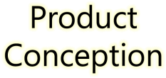
































Microsoft Security Development Lifecycle (SDL)
SDL Book:
http://www.microsoft.com/mspress/books/8753.aspx
Official SDL Web Site: http://www.microsoft.com/sdl

Slide 22


Microsoft Writing Secure Code Book Series
Writing Secure Code,
2nd Edition:
http://www.microsoft.com/mspress/books/5957.aspx
Writing Secure Code for Windows Vista:
http://www.microsoft.com/mspress/books/10723.aspx

Slide 23
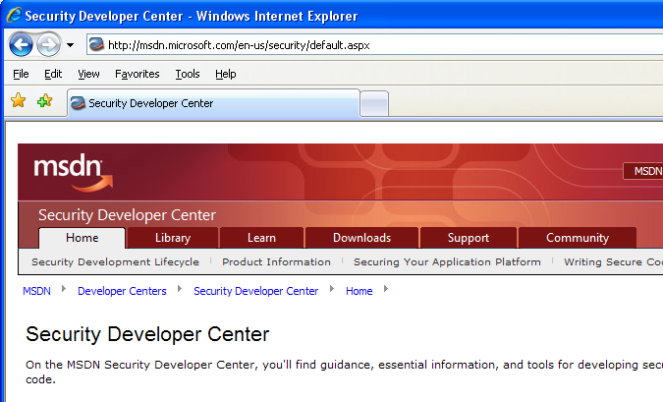

Microsoft Developer Network (MSDN) Security Developer Center
Official Web site: http://msdn.microsoft.com/security

Slide 24
Secure Development Blogs
The Microsoft Security Development Lifecycle (SDL) Blog: http://blogs.msdn.com/sdl
Michael Howard’s Blog: http://blogs.msdn.com/michael_howard

Slide 25

Microsoft Hunting Security Bugs
Hunting Security Bugs:
http://www.microsoft.com/mspress/books/8485.aspx

Slide 26
Additional SDL Training Content
Secure Design Principles
Secure Implementation Principles
Secure Verification Principles
SQL Injection Vulnerabilities
Cross-Site Scripting Vulnerabilities
Buffer Overflow Vulnerabilities

